Slide 1

THIS IS NOT A DRILL
Crisis Management

Slide 2
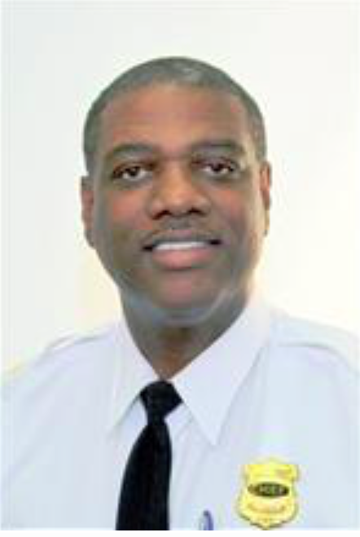
Chief Lester Fultz

Slide 3
CRITICAL INCIDENT
Any event that disrupts or potentially disrupts the school day or interrupts learning and teaching

Slide 4
school fight
fire/evacuation
bomb threat
Lockdown
death/loss of student/staff member
Bus accident, injury at school,
allegation of serious/criminal misconduct
Anything that warrants the immediate attention of school staff, security, emergency services or police to manage the incident

Slide 5
NOT EVERY INCIDENT REQUIRES COMMUNICATION ABOUT THE INCIDENT TO
STAFF, FAMILIES, PUBLIC AND/OR MEDIA
Not every incident is critical.
Not every critical incident is a crisis.
Some incidents require communication only to those personally affected
Some incidents warrant communication to a broader audience than those personally affected

Slide 6
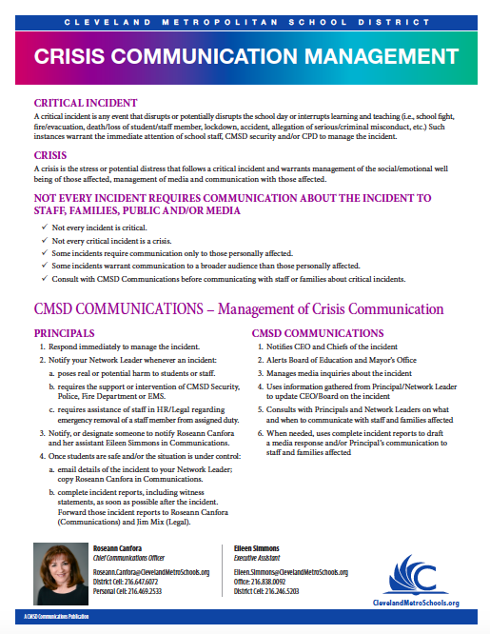

Slide 7
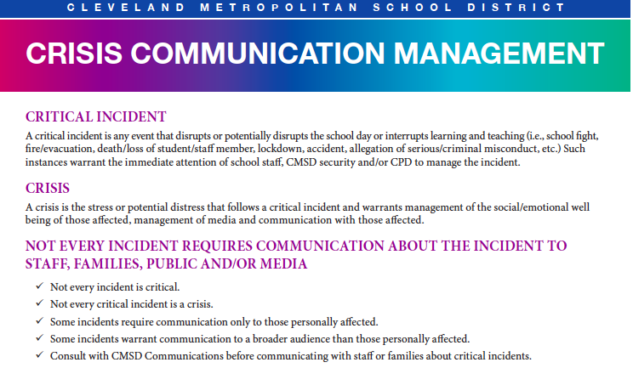

Slide 8
CRISIS
The stress or potential distress that follows a critical incident and warrants emergency management of the
social/emotional well being of those affected, management of heightened media attention and timely communication with those affected.

Slide 9



Slide 10
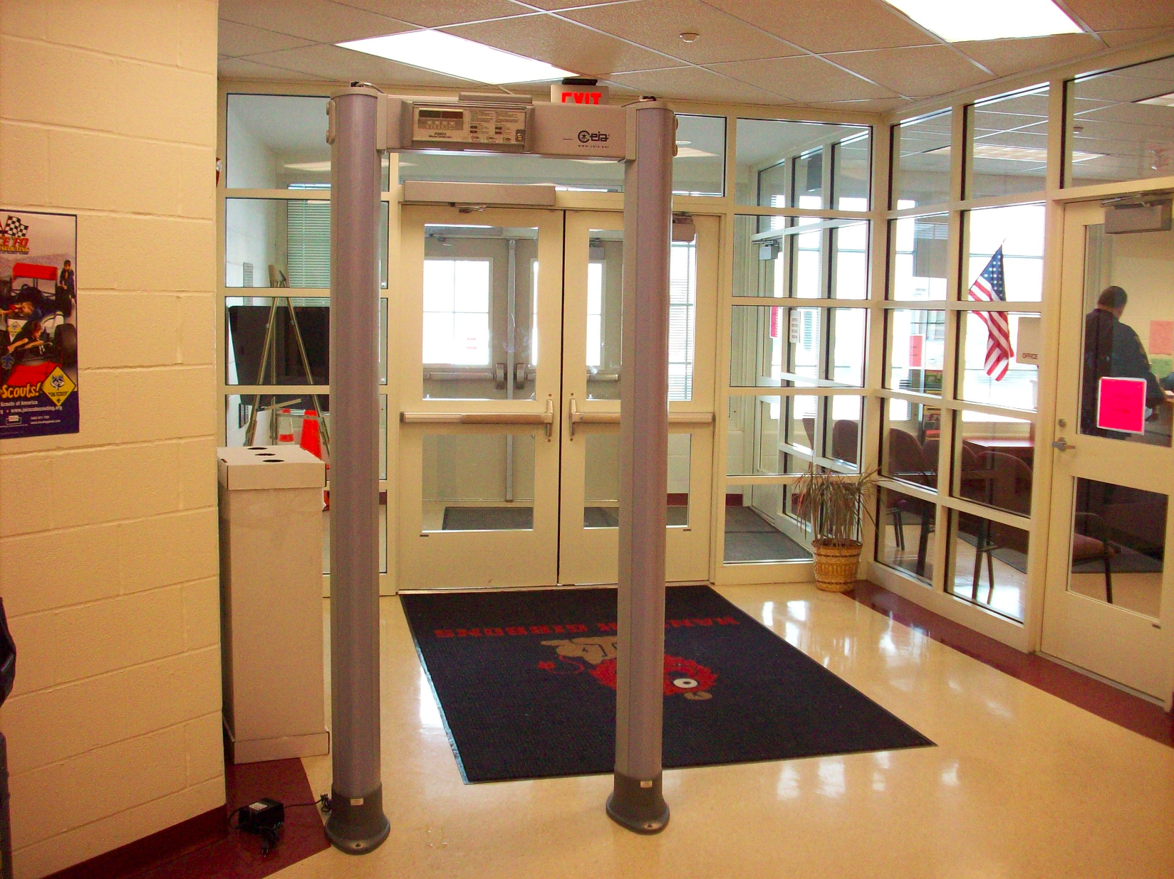
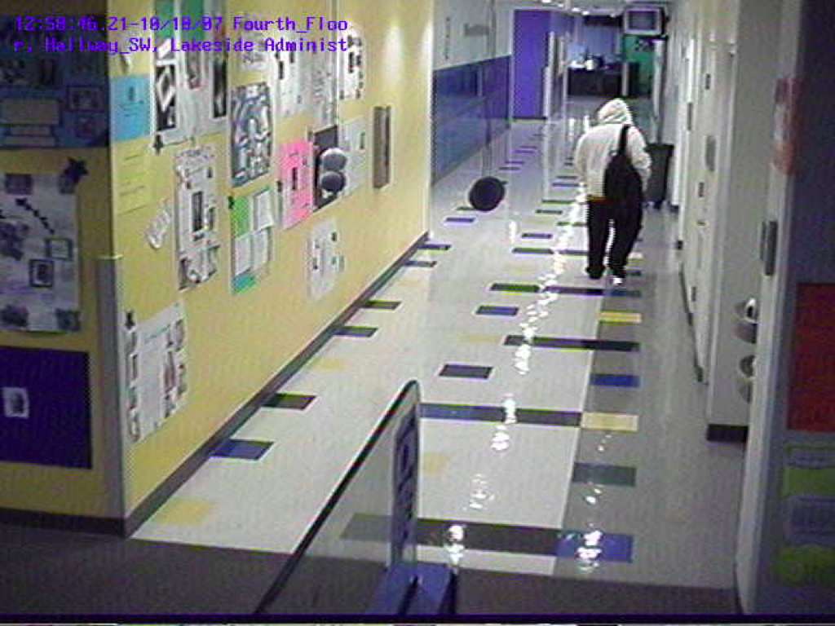
Success Tech High School
Cleveland, Ohio
2007

Slide 11
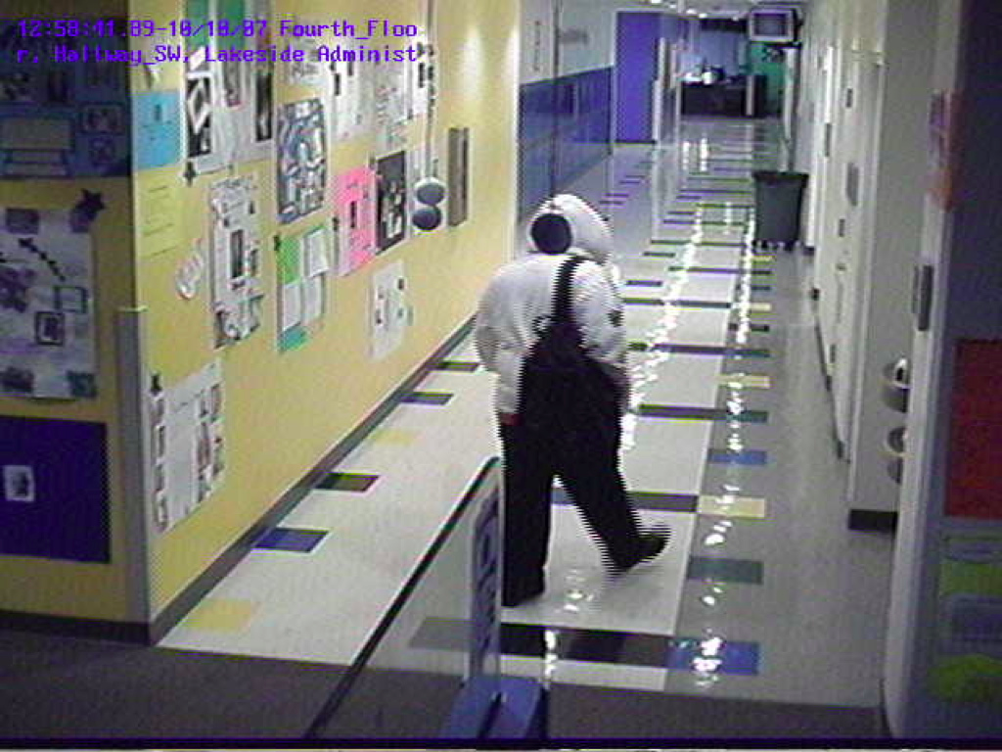
Our student

Slide 12
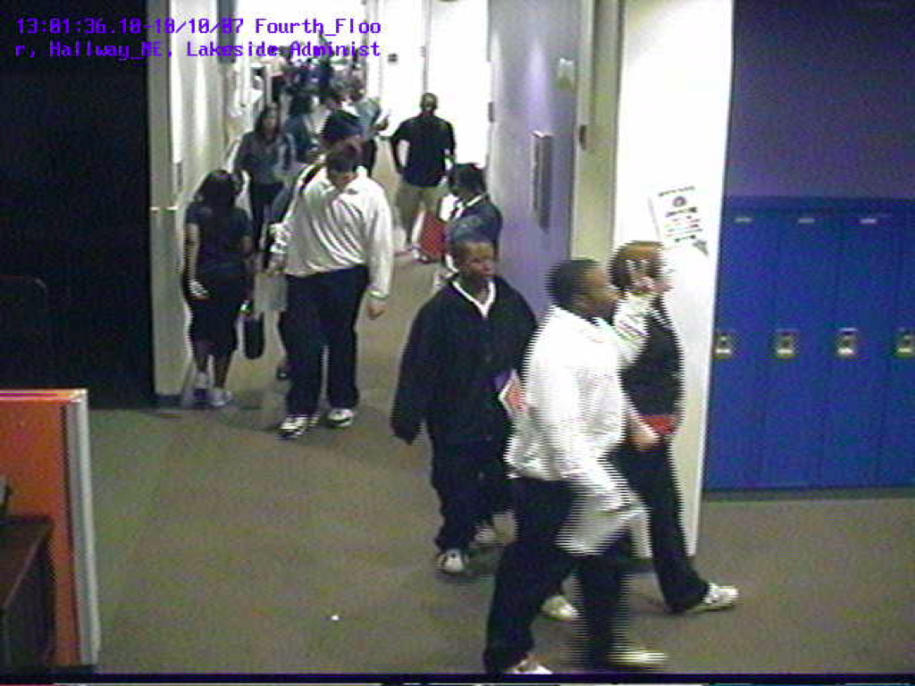
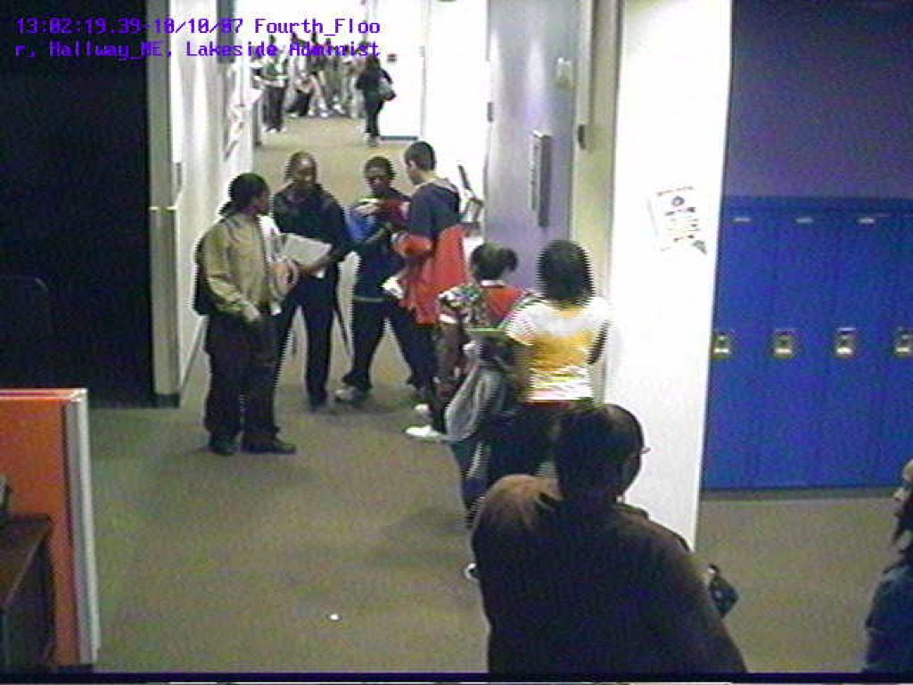
It was a normal day...

Slide 13
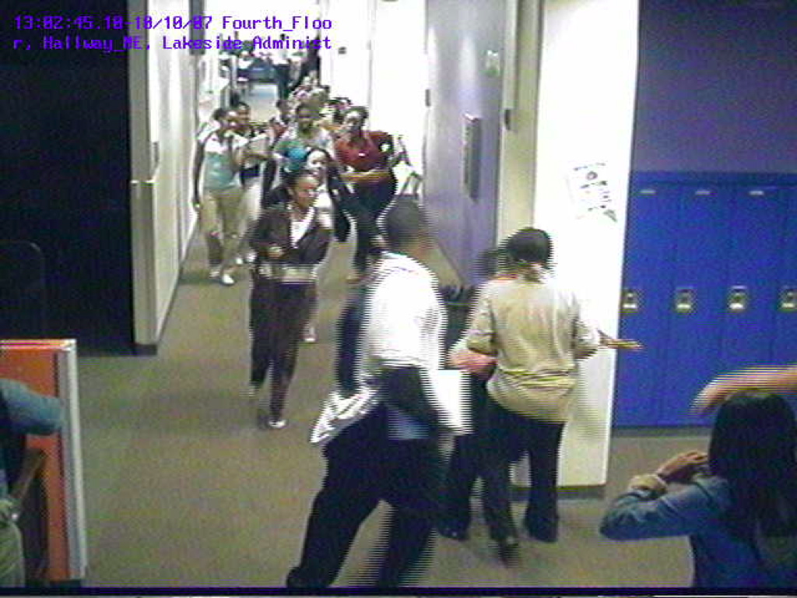
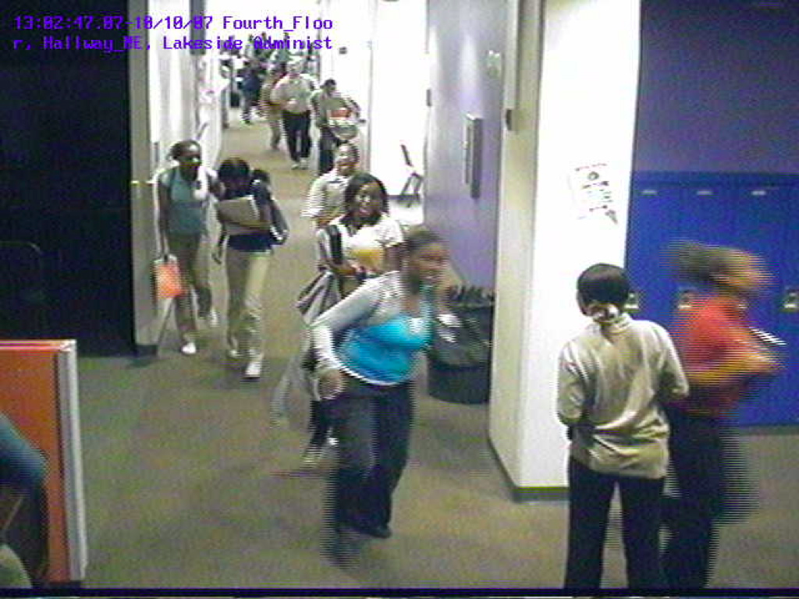
…and then it wasn't

Slide 14
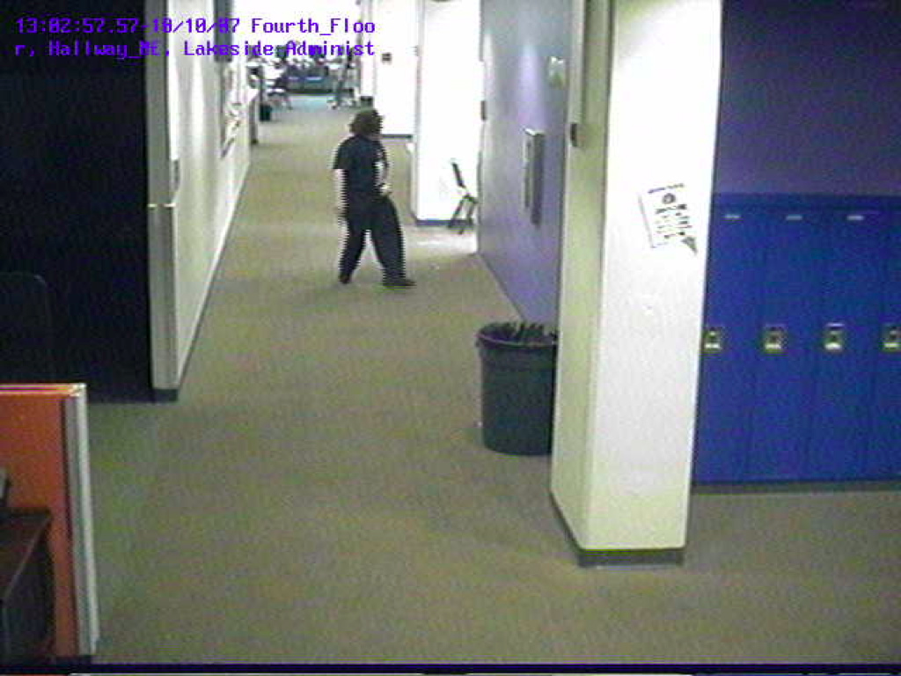
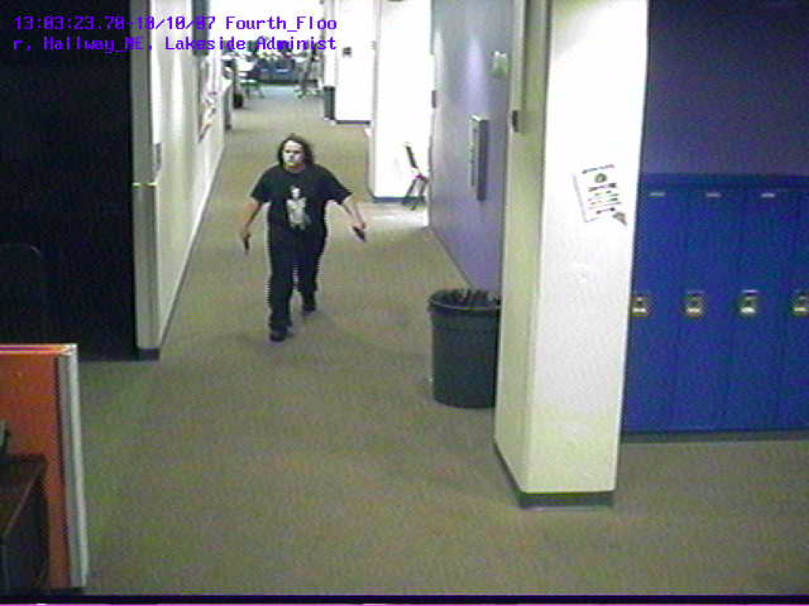
Active Shooter? Student? Intruder? Did we miss something?

Slide 15
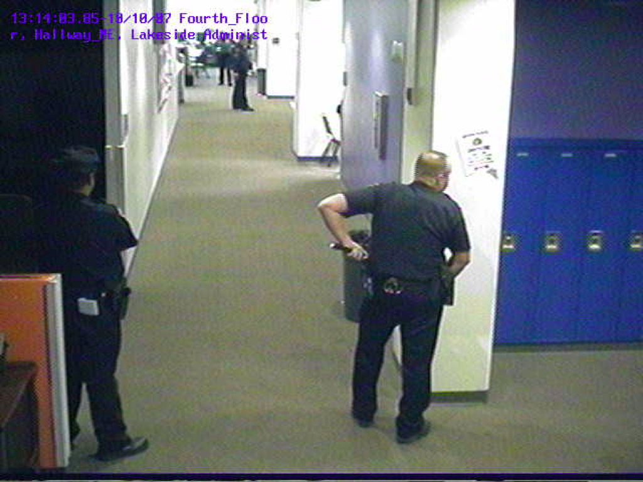
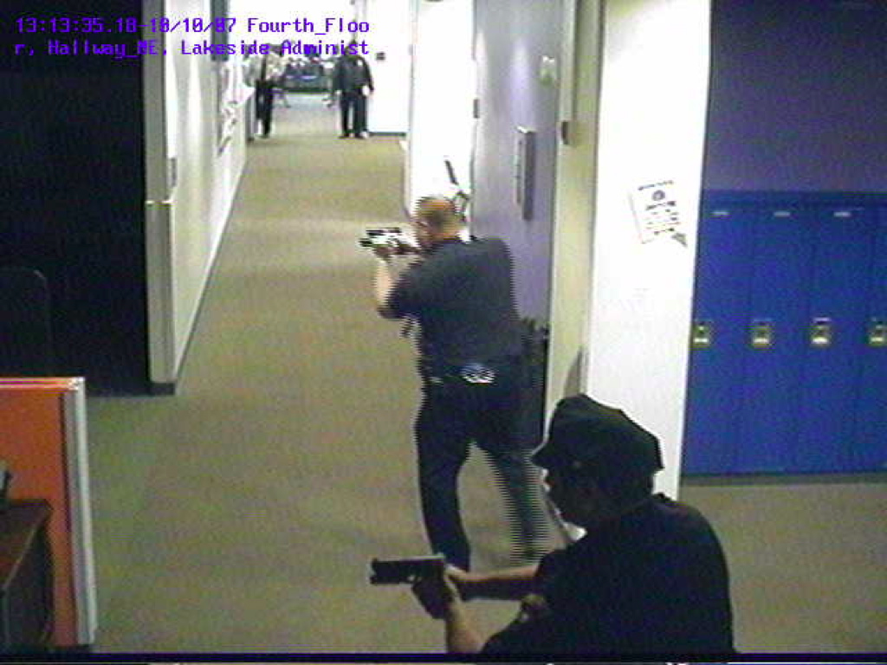
Police respond
Notes:
What is role now
How do we share information

Slide 16
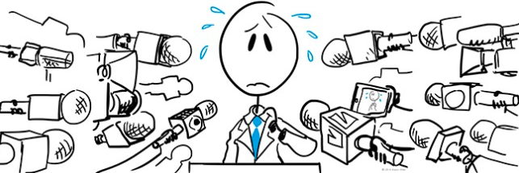
People react

Slide 17


Slide 18
Managing the Unthinkable

Slide 19
ACTIVE SHOOTER TRAINING:
It’s not just because we have to…
R.C. § 3313.536 & Ohio Substitute House Bill 422
Requires public and private schools to adopt school safety plans.
Post-Katrina Emergency Management Reform Act of 2006
Requires government entities to facilitate reunification of minors with their parents/guardians.
The Ohio Revised Code (ORC), Ohio Administrative Code (OAC) and the City Charters
Outlines the authority of the City, under the direction of the Mayor and the Director of Public Safety, to address issues in the event of an emergency.

Slide 20
OUR CRISIS….. But ‘theirs’ too.
City charters describe the responsibilities and powers delegated to the Mayor and City Department Directors.
R.C. § 5502.28 - National Incident Management System (NIMS) directs all departments, agencies, and political subdivisions within the state to utilize the system for incident management.
Mayoral Proclamations outline adoption of the National Incident Command System (NIMS), directing all City of Cleveland elected officials, departments, agencies, and offices to utilize NIMS.

Slide 21
Expected vs. Unexpected Events
Storm
Increased readiness
Resources available and plan in place
Active shooter
Immediate response
Readiness
Crisis plan and pre-positioned resources
Reunification
Readiness for caring support and compassion to defuse heightened emotions at the site

Slide 22
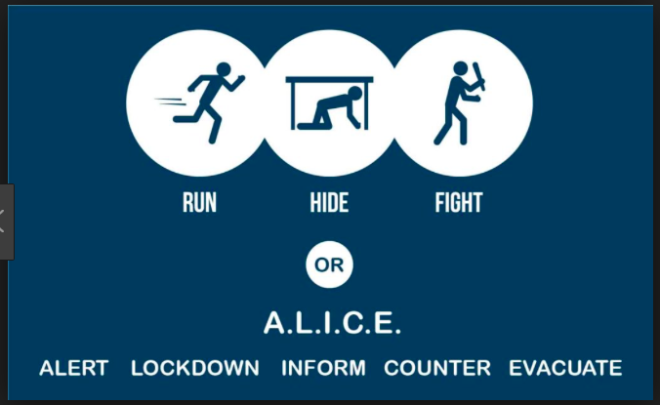

Slide 23


Slide 24
cHAOS
Anxiety is immediate
Communication starts without us
Students seek assistance
Families seek information
A surge of individuals arrive at the scene(s) and key locations
Social media becomes a source for updates
Initial data and information is collected in silos

Slide 25
Know Your First Responders
Department of Public Safety - Office of Emergency Management
Safety Plan – Data Base
Drills, tabletop exercises, full-scale exercises (compliance with OEM), facilities identification
Reunification plan
Staffing plan for Family Reunification Centers
Department of Public Works
Maintains list of facilities
Coordinates list with Office of Emergency Management for evacuations & reunification centers

Slide 26
Department of Public Health – County Board of Health
Coordinates volunteer healthcare providers (e.g. nurses, physicians, pharmacists)
Medical Reserve Corps (MRC) at evacuation and reunification centers
Verifies credentials and coordinates assets
American Red Cross
Maintain a corps of volunteers that can staff reunification center
Train staff on processes for providing services
FBI – Homeland Security

Slide 27
School District
Develop and maintain School Safety Plans (per R.C. § 3313.536 and Ohio Substitute House Bill 422)
Provide copies of School Safety Plan to the City as required by R.C. § 3313.536 and Ohio Substitute House Bill 422.
Periodically exercise Safety drills and Reunification Plans.

Slide 28


Slide 29
Personal photographs and text messages that Roseann shared from her Broward County Public Schools experience were removed from this shared version of her presentation.
[Photos of superintendent, students and families, text exchanges between the PIO Office and other central administrators on the day of the shooting] - News coverage was left in the presentation deck.

Slide 30
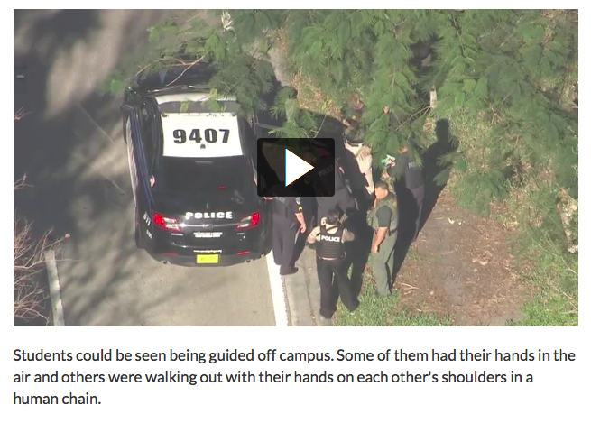

Slide 31
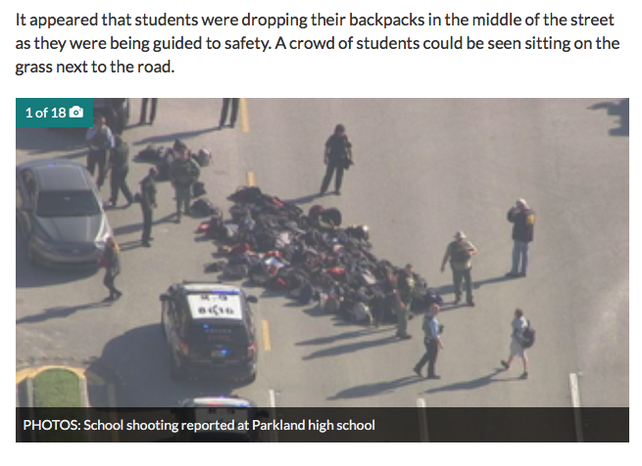

Slide 32
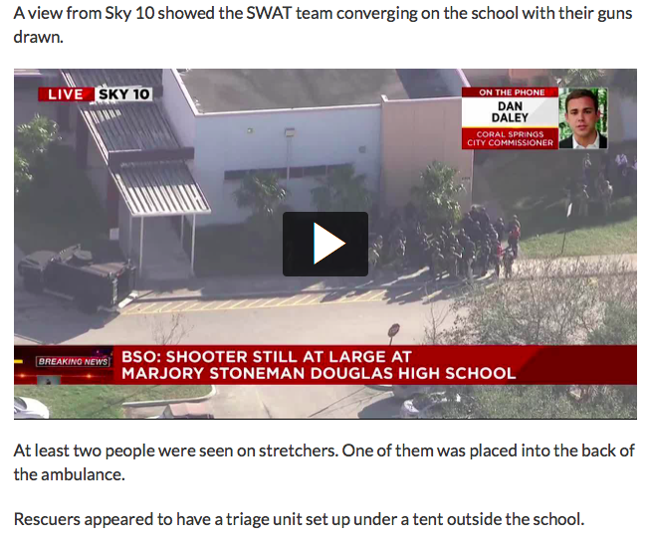

Slide 33


Slide 34
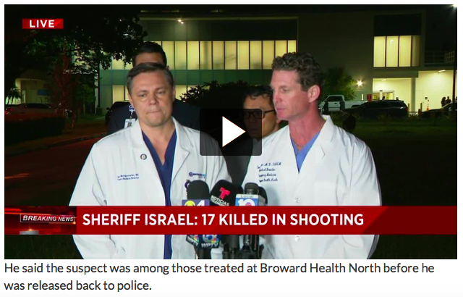

Slide 35


Slide 36


Slide 37
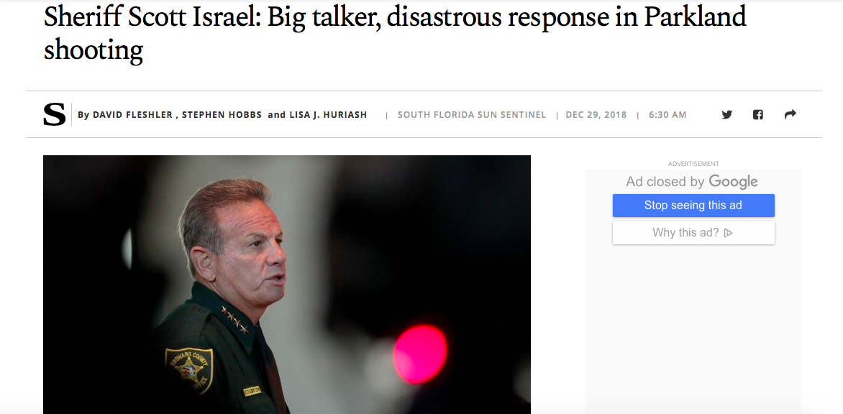

Slide 38


Slide 39
CRISIS COMMUNICATION
IS ABOUT PREPAREDNESS
Show concern for people impacted
Demonstrate that you are capable of responding
Keep media & public informed
Balance the fear and anger out there / counter with calm, thoughtful responses

Slide 40
COMMUNICATE FIRST & FAST
Take the lead in the information process - role of sheriff in Broward
Issue the first news release within the hour – get your superintendent in front of the camera!
Provide information & updates as soon as they are known
Gather background info – show preparedness and transparency
LESSONS
CMSD 2007 Shooting
Ariel Castro – Taking care of local media

Slide 41
BE HONEST & TRANSPARENT
Tell the truth
Don’t shut the information down – Lessons from Broward
Don’t speculate – don’t leave your superintendent hanging out to dry
Tell the good and bad news – Both are happening!
If answer is unknown – promise to find answer and follow up
If facts are unknown – fill apps and social media with background & relevant info
It takes a Team Effort

Slide 42
SHOW COMPASSION
CMSD went silent
superintendent was not in town
communications officer relied first responders for information and for communications with public
Show human concern
people are shocked, angry, scared, hurt
Respect that
Listen to them
Choose words carefully
Avoid blame or assumption of liability before facts are known

Slide 43
ENGAGE YOUR SCHOOL COMMUNITY
FOUR ASPECTS OF CRISIS RESPONSE:
Mitigation & Prevention
Preparedness
Response
Recovery

Slide 44
BE PREPARED
Active shooter training & pocket guides
Classroom emergency response flip chart
Family reunification plan

Slide 45
CRISIS COMMUNICATION
STARTS WITH THE CRISIS, NOT AFTER
You can wing it when it comes to media—telling what we know and don’t know
You can’t “wing it” when it comes to communicating to and reuniting with families
Mental health demands answers
District must maintain responsibility for chain of custody of every student
Know how public information will descend through ranks

Slide 46
FALLOUT FROM SUCCESS TECH & BROWARD
CMSD Communication Officer was fired
Broward County Public Information Officer transferred, then left
Broward County Sheriff was fired
Public Relations Consultant brought help, but also challenges

Slide 47
Together we can….
Avoid complicating what will surely be an already, chaotic, anxiety-filled scene.
Know the response plan(s) and become familiar with the actions of first responders and flow of information from
their respective PIO’s
Put an orderly reunification plan into action will defuse emotion escalating throughout the community
Show control, responsibility and compassion for the needs of families to connect with their kids

Slide 48
HAVE A CRISIS PLAN!
Parent check-in location
Delivery of students to staging area
Controlled lines of sight for orderly flow
Notification of and Communication with parents
Completion of Reunification Cards
Streamlining & Self-sorting during check-in
KNOW THE PROCESSES HERE AMD AROUND US
Roles of “Reunifiers” - recovering students from staging to delivery to parent
Familiarity with Medical, Notification, Treatment, Investigative and Support contingencies

Slide 49
THIS IS NOT A DRILL
Crisis Management

